Slide 1
IT as a Team Sport
IT All Staff Conference
M. Mundrane
6 November 2023

Slide 2
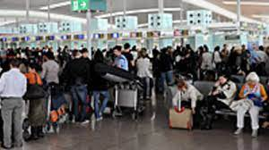
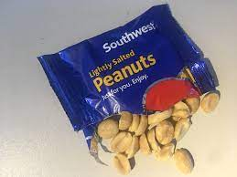
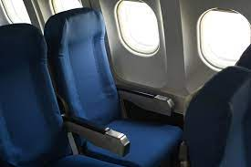
Joys of Travel
We are all in this together!

Slide 3
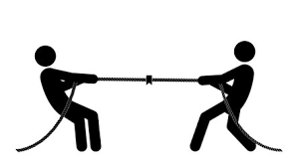
Negotiation

Slide 4
Negotiation
All about understanding…
You
Them
Goals
Constraints
Common ground

Slide 5
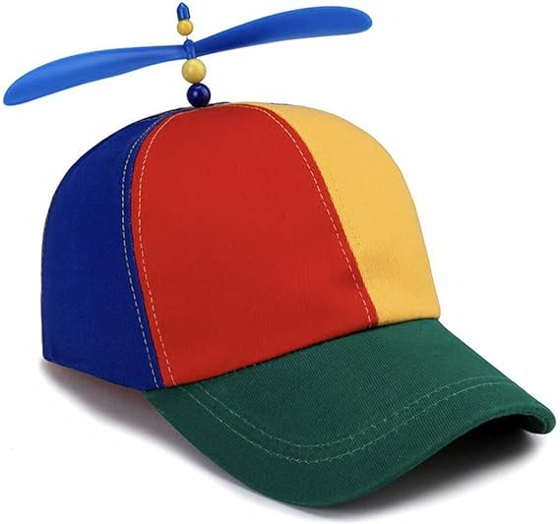
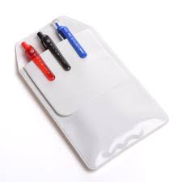
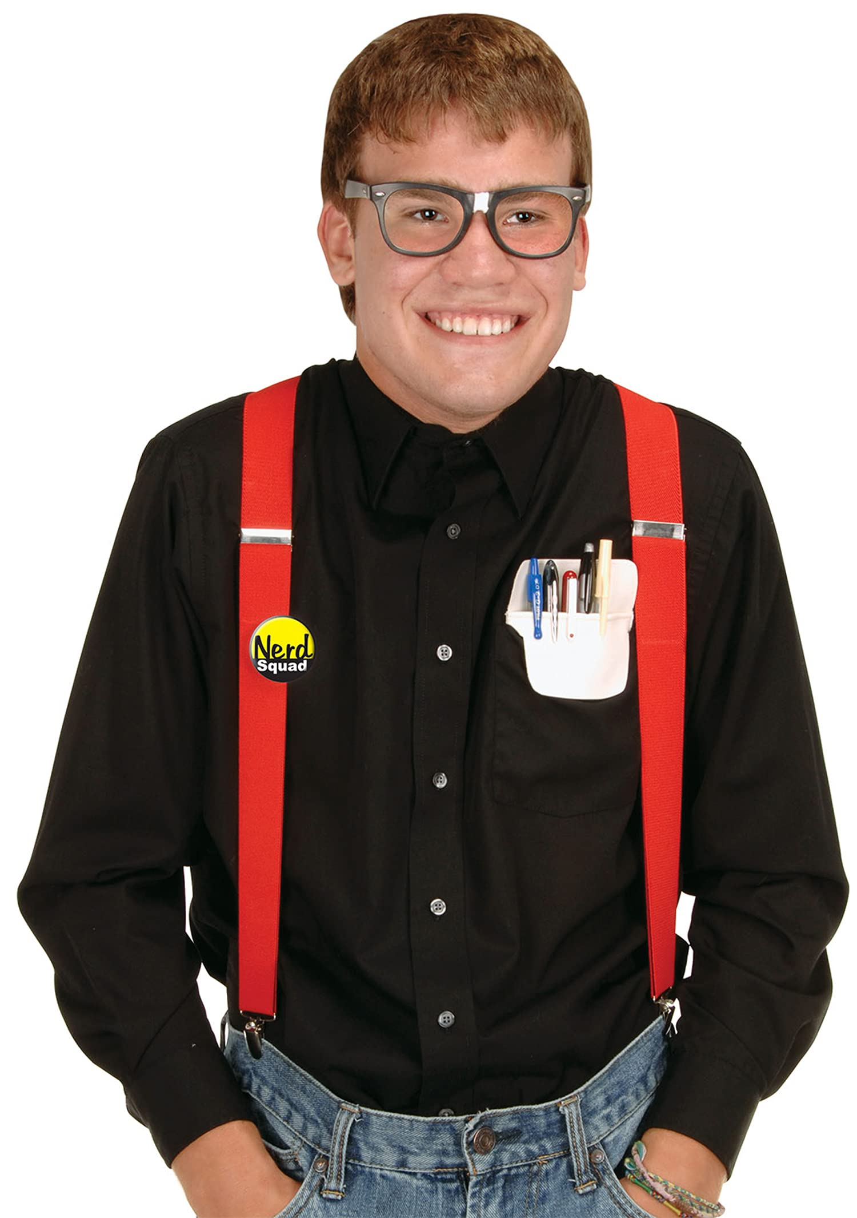
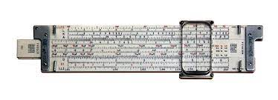
Colleagues
People are hard!

Slide 6
IT Collaboration
Cooperation
Assertiveness
Communication
Trust/Respect
Execution
Accountability
Honest negotiation!

Slide 7
IT Collaboration
Be self aware.
Understand others.
Strive positive outcomes.
Work for the success of others.
Earn and give trust.
Be your best self.

Slide 8
Thank You
Questions?

Slide 9
Copyright
Copyright © University of Connecticut Information Technology Services 2023. This work is the intellectual property of the author. Permission is granted for this material to be shared for non-commercial, educational purposes provided that this copyright statement appears on the reproduced materials and notice is given that the copying is by permission of the author. To disseminate otherwise or to republish requires written permission from the author.

